Slide 1
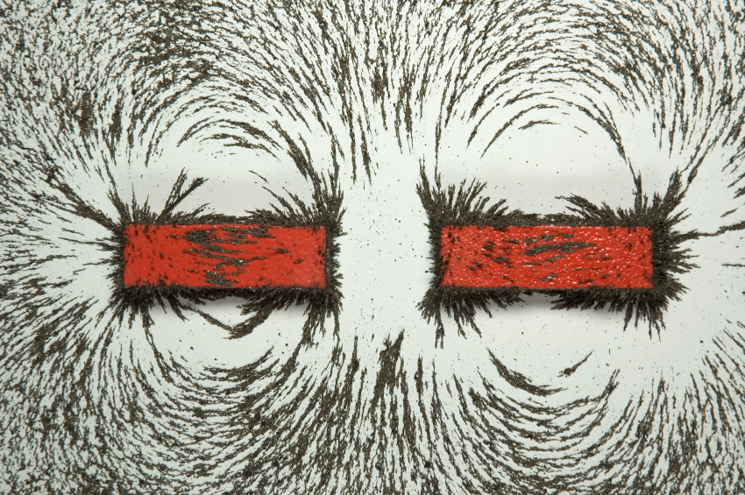
CHAPTER 29:
Magnetic Fields and Sources
photo courtesy of Mr. White
1.)

Slide 2
Relativity and Magnetism
--Newton’s Classical Mechanics demands that the speed of light depend upon the relative motion between the frame of reference of the light source and the observer’s frame (think of about a passing car’s speed on the freeway—how fast it passes you depends upon how fast you are going).
--Yet because alternating magnetic fields (B-flds) induce electric fields (E-flds), and alternating E-flds induce B-flds, the only way an alternating E-fld can coupled with an alternating B-fld to produce an electromagnetic wave (i.e., a wave in which the alternating E-fld feeds the B-fld and the alternating B-fld feeds the E-fld), is if, according to Maxwell’s equations, the wave’s velocity is , the speed of light.
--You can’t have it both ways. The speed of light is either frame-of-reference dependent alla Newton, or it’s a fixed value independent of frame-of-reference alla Maxwell.
--This conundrum is what motivated Einstein to develop his Theory of Special Relativity, a form of Mechanics that assume that the speed of light is the same in all frames of reference.
2.)

Slide 3
--One of the stranger characteristics of Special Relativity is that if you have an object that is approaching at relativistic speeds, it will length contract. And, in fact, this length contraction phenomenon will occur even at classical speeds (though observing it at classical speeds is difficult).
--With this in mind, consider a wire with conventional current flowing through it (i.e., assume positive charge flow). If you fire a positive charge opposite the direction of current flow, an interesting thing is observed.
The charge will feel a force that motivates it to veer away from the wire. So what’s going on?
path taken
3.)

Slide 4
As positive charge carriers move onto the wire (with electrons assumed stationary), an equal number of positive charge carriers move off the wire. That means the number of positive and negative charge stays even throughout time, the wire stays electrically neutral, and there’s no good reason for the moving test charge to feel a force. But it does. This led early theorists to conclude that there must be a force, a magnetic force, affecting the moving charge . . . except that isn’t what’s really happening here. To see this, we have to look at the situation through the perspective of the moving charge .
-
-
-
-
-
-
-
-
-
-
e
e
e
e
e
e
e
e
e
e
+
+
+
+
+
+
+
+
+
+
p
p
p
p
p
p
p
p
p
p
assume velocity of positive charge is
4.)

Slide 5
In the frame of reference attached to , is not moving. What’s more, as far as
is concerned, both the electrons and the wire are seen to be moving to the left with velocity , and the protons are seen to be moving to the left with velocity
The sketch below show all of this.
electron and wire velocity:
(stationary)
-
e
+
p
proton velocity:
5.)

Slide 6
What’s important to notice here is that because the protons are moving faster than the electrons, they will length contract more than will the electrons. When they do so, from the moving charge’s perspective, there appears to be more protons on the wire than electrons.
-
-
-
-
-
-
-
-
-
-
-
-
e
e
e
e
e
e
e
e
e
e
e
e
+
+
+
+
+
+
+
+
+
+
+
+
+
+
p
p
p
p
p
p
p
p
p
p
p
p
p
p
Protons length contract more than electrons. More protons means the wire looks electrically positive and an electric field is set up pointing outward from the wire.
6.)

Slide 7
With more protons apparently on the wire, there is an electric field generated emanating outward from the wire. It is that electric field that the responds to.
E-field due to preponderance of positive charge
-
-
-
-
-
-
-
-
-
-
-
-
e
e
e
e
e
e
e
e
e
e
e
e
+
+
+
+
+
+
+
+
+
+
+
+
+
+
p
p
p
p
p
p
p
p
p
p
p
p
p
p
E-field due to preponderance of positive charge
7.)

Slide 8
In short, what was described by early researchers as a MAGNETIC EFFECT was (and is) really a RELATIVISTIC EFFECT.
Still, the Classical Theory of Magnetism is a good theory in the everyday world (just as is the case with Newtonian Mechanics), so that’s what you will be spending the next several weeks learning.
8.)

Slide 9
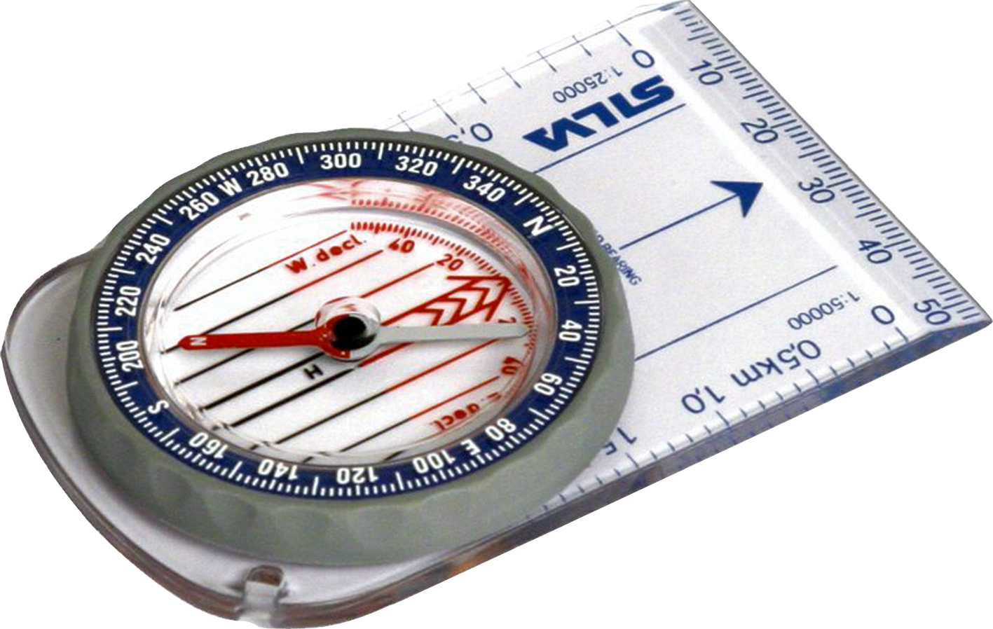
General Information
Electric Fields
Magnetic Fields
--magnetic fields (abbreviated as B-flds), with units of teslas in the MKS system, are NOT modified force fields (release a charge in a B-fld and it will just sit there);
--electric fields (abbreviated as E-flds), with units of newtons per coulomb or volt per meter, are modified force fields (release a charge in an E-fld and it will accelerate);
--magnetic forces do exist when a charge moves through a B-fld—they are centripetal and are governed by the relationship:
--electric fields are generated with the presence of charge;
--B-fields are generated by charge in motion;
--an electric field’s direction is defined as the direction a positive charge will accelerate if released in the field;
--a B-field’s direction is defined as the direction a compass points when placed in the field;
--electric field lines:
--magnetic field lines:
--go from positive to negative charge;
--go from north to south pole, or circle around current carrying wire;
--identify the E-fld’s direction in a region;
--are closer together where E-flds are more intense;
--identify the B-fld’s direction in a region;
--are closer together where B-flds are more intense;
9.)

Slide 10
Terminology and the Compass
Place a compass in the earth’s magnetic field.
south magnetic pole
north geographic pole
The compass end that originally pointed toward the north geographic hemisphere was called the north geographic seeking magnetic pole.
earth
compass
With time, the word geographic was dropped leaving the north seeking magnetic pole, and with even more time, the seeking and magnetic was dropped leaving us with north pole.
north geographic seeking pole
south geographic pole
north magnetic pole
Problem is, north poles are attracted to south poles, which means that given the definition, there must be a south magnetic pole in the north geographic hemisphere. Not very esthetically pleasing, but that’s life (and it’ll switch directions in another 200,000 or so years due to slow oscillatory patterns in the earth’s magma).
10.)

Slide 11
Bar Magnets
electron spin about an axis producing a B-fld
If magnetic fields are generated by charge in motion, where is the motion associated with a bar magnet?
An atom’s spin quantum number highlights the fact that electrons spin up or down, depending.
electron
In most atoms, approximately the same number of electrons spin in one direction as the other, but in certain atoms (the ferromagnetic ones), they spin considerably more in one direction than the other.
The most prominent example of a ferromagnetic material is iron, with six more electrons spinning in one direction than the other. As such, EACH IRON ATOM IS A MINI-MAGNET UNTO ITSELF.
11.)

Slide 12
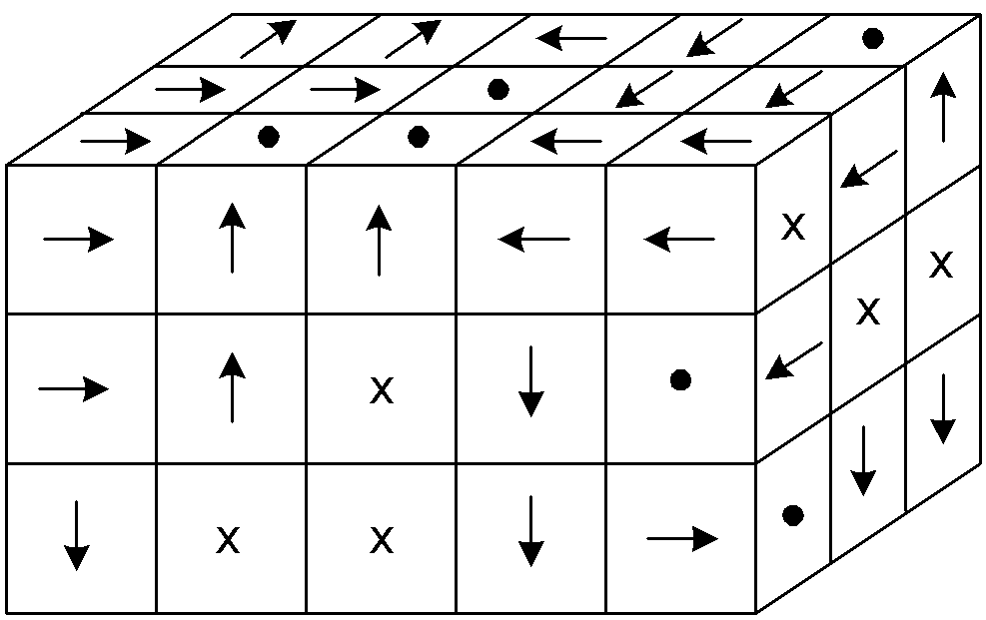
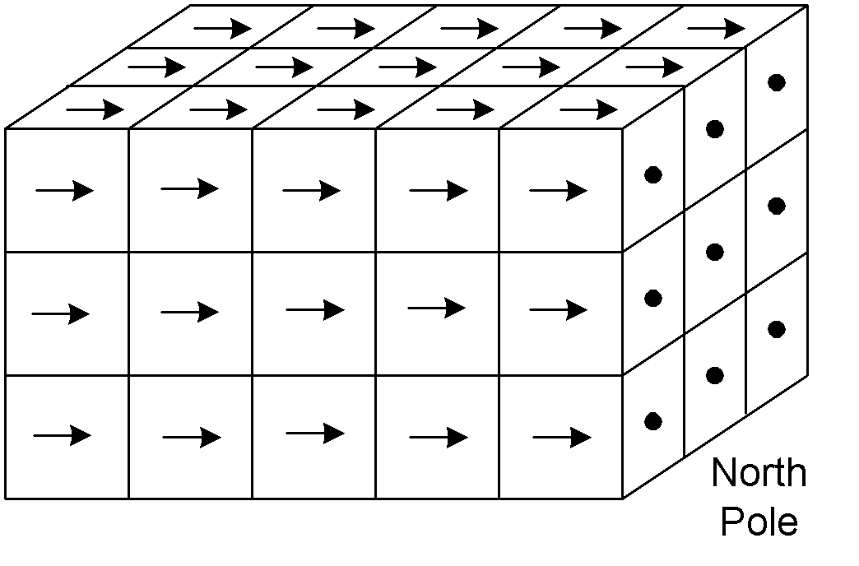
So how can a piece of iron be magnetic under some conditions and not under other conditions (there are, after all, iron nails that do not exhibit magnetic characteristics at all). (The explanation is called Ampere’s Theory of Magnetism.)
Enter the magnetic domain. What happens is this: Atoms within irregular, microscopic regions, called domains, align themselves so that all of their magnetic fields are in the same direction.
When the domains are themselves aligned, the material acts like a magnet. When the domains are NOT aligned, the net magnetic effect is lost (in some cases, all that is needed to de-magnetize a magnetic is to have thermal agitation shake the domains out of alignment). In any case, the first sketch below is without alignment, the second with alignment.
sketches courtesy of Mr. White
domains aligned
domains unaligned (not realistic rendering)
12.)
Notes:
Microscopic examination reveals that a magnet is made up of tiny (up to 1mm wide or long) regions called domains. The domain behaves as its own tiny magnet, with a specific size and a specific north-south pole orientation.
In an unmagnetized piece of iron, the domains don’t have any preferential alignment. In a magnetized piece of iron, the domains are aligned, giving the piece of iron a preferential magnetic orientation.
To make a magnet, take a piece of ferromagnetic material, and subject it to a strong magnetic field, which will cause the domains to shift (somewhat temporarily) into alignment with that field.
A magnet can be demagnetized by striking it repeatedly, which jars the magnetic domains out of alignment. (Dropping magnets is bad for them.)

Slide 13
3 Types of Magnetism
Ferromagnetism - material has a permanent “magnetic moment,” due to microscopic “domains” in which moments are aligned.
Paramagnetism - materials has a small magnetic susceptibility, that only becomes evident when placed in an external magnetic field.
Diamagnetism - material does not have permanent magnetic moments. In the presence of an external magnetic field, a weak magnetic moment is induced in a direction opposite to the external field.
13.)

Slide 14
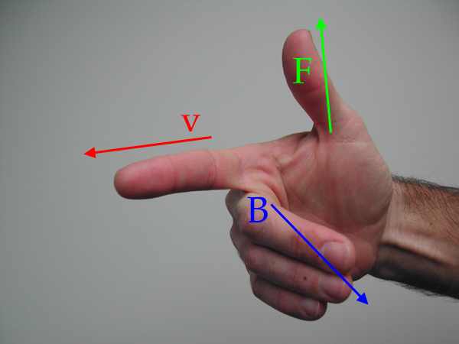
Magnetic Force
When charge moves through a magnetic field, it may or may not feel a force, depending upon its motion. If present, that force will be:
The magnitude is , where q is the size of the charge,
is the magnitude of the velocity vector, is the magnitude of the magnetic field and is the angle between the line of the two vectors.
The direction is determined using the right-hand rule.
sketch courtesy of Mr. White
14.)

Slide 15
Example 1: (courtesy of Mr. White)
Identify the missing vector in these diagrams. Assume red signifies negative charges, blue positive charges. The responses are in green
B
F
v
zip
v
F
F
v
F
F
F
15.)

Slide 16
Fine Print for
The right-hand-rule determine the direction of force for a positive charge.
Magnetic forces are centripetal forces acting perpendicular to magnetic fields (whereas electric forces act along electric fields). That means magnetic forces DO NO WORK on charges that feel their effect.
Magnetic forces are experience only by charges in motion.
16.)

Slide 17
Example 2: A proton moving upward with speed in a magnetic field feels a force of to the west. When moving horizontally to the north, it feels no force. Find the magnitude and direction of the magnetic field in this region. (courtesy of Mr. White)
Because no force is felt when the proton is moving northward, the magnetic field must either be toward the north or the south.
Reverse engineering the right-hand-rule suggests if the field is to the north*, the velocity vector would have to be out of the page to generate a force to the west, with a magnitude of:
*Note that if the field was to the south, the velocity vector would be into the page.
17.)

Slide 18
Example 3: A charge q of mass m is moving with constant velocity v at right angles to a magnetic field B. (idea courtesy of Mr. White)
a.) What kind of motion will it execute?
Because magnetic forces are centripetal, the mass will follow a circular path.
b.) What is the radius of the motion’s path?
18.)

Slide 19
Lorentz Relationship
When both magnetic and electric forces act, the relationship looks like:
19.)

Slide 20
Example 5 (mass spectrometer): An unknown mass is volatalizes (made into a gas), had its molecules singly ionized (had one electron stripped away), accelerated through a
potential difference to give them velocity, and sent through a velocity trap made up of a 95,000 V/m E-fld and a .93 teslas B-fld. The molecules that make it through the trap move into a region in which there is only the B-fld.
a.) What is the velocity of the molecules that make it through the trap?
220.)

Slide 21
b.) Draw in the path of the molecules in the far right chamber.
They will circle upward.
c.) If the radius of the arc is observed to be .0667 meters, what was the mass of the particle (that’s what these devices are designed to do—determine the mass of an unknown material from which the identification of
the material can be had). In the region in which there exists only a B-fld:
(This is the molecular weight of table salt.)
21.)

Slide 22
Point of Order
Magnetic forces exist on charges moving through magnetic fields ONLY when the charges cut across magnetic field lines. Until now, the only examples we’ve viewed have been situations in which the charges have cut across at right-angles to the field lines. What happens when they cut across at an angle?
--The velocity component perpendicular to the B-fld will generate a magnetic force that will motivate the charge to circle (magnetic forces are centripetal in nature);
--The parallel component will simply provide momentum for the charge to continue to move in that parallel direction.
--The net effect is that the charge will helix along the B-fld lines.
22.)

Slide 23
Example 8: Two metal ramps (in red) at an angle are d units apart and are bathed in a downward B-fld. A battery wire is connected to each ramp making a circuit. A metal rod would slide frictionless down the ramp if it were not for the magnetic force provided by the B-fld. In fact, in this case the rod is motionless. Assuming the net resistance of the system is R:
3-d view:
a.) What must the polarity of the battery be if the rod is to stay stationary on the ramp (again, assume the rod is frictionless).
side view:
For equilibrium, you can see from observation that you need a component of the magnetic force to the left to counter the component of gravity to the right. Reverse engineering
yields the need for a current into the page to generate a magnetic force in that direction . . . So the polarity of the battery must be high-side on left.
23.)

Slide 24
b.) How big must the battery voltage be to effect this situation?
Doing a f.d.b. and breaking the forces into components, we can determine i:
From Ohm’s Law:
24.)

Slide 25
Show and Tell—the Galvanometer
Consider a current-carrying loop of width a and height c, pinned at the top and bottom, bathed in a magnetic field.
How will the current i respond to the B-fld?
Look down from the top and ignore the billowing of magnetic field generated by the bar magnets. In that view, the current moves across the upper section of wire as shown, moves down into the page in the section on
Look down
the right, and moves out of the page in the section on the lower left.
The r.h.r. suggests the direction of the magnetic forces on those sections are as shown.
25.)

Slide 26
The magnitude of the magnetic force will be:
The total torque due to the current in the wires into and out of the page is:
where is the angle between the line of the force and the line of the position vector .
26.)

Slide 27
Two observations:
1.) There could be N loops in our coil, so the most general torque expression should be the torque expression we’ve already derived multiplied by N.
2.) Notice that ac is the area A of the loop.
With this, we can write the torque calculation as:
--Although this is not something I think the AP folks are likely to ever test on, consider:
Lay your right-hand on the loop in the direction of the current. The direction your outstretched thumb points will define a direction perpendicular to the face of the coil.
Define a vector, called the magnetic moment , whose direction is in that perpendicular direction and whose magnitude is equal to .
Crossing that magnetic moment vector into the B-fld yields a magnitude:
which is the torque on the coil . . .
27.)

Slide 28
Aside from giving physics teachers an excuse for having students do torque calculations in an E&M section, the real usefulness of all of this quite cool.
0
5
5
If you put a pinned coil in a magnetic field, attach a spring to it to provide a restoring torque, then attach a pointer hung over a scale, you have the makings of a meter.
N
i
S
And, in fact, that is exactly how a GALVANOMETER is made—it’s a coil suspended in a magnetic field with a spring attached to it to provide a restoring torque, so that when you put through it, the torque provided by the moving current in the B-fld coupled with the restoring torque sees the pointer swing “full deflection” over the scale . . . and that is very cool . . .
28.)

Slide 29
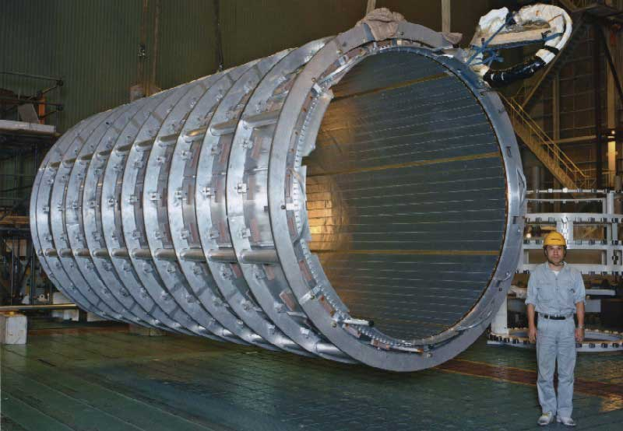
Sources of Magnetic Fields
Cern’s single-walled coil operates at 7600 amps and produces a 2.0 Tesla B-fld. http://atlas-magnet.web.cern.ch/atlas-magnet/info/project/ATLAS_Magnet_Leaflet-ds.pdf
Photo and info courtesy of Mr. White
29.)

Slide 30
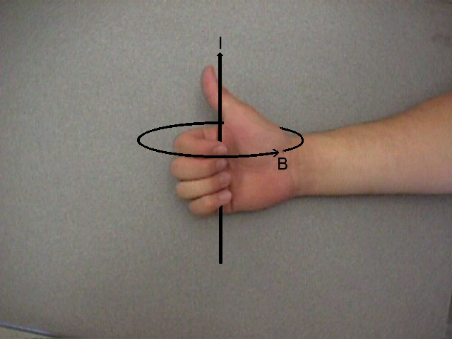
B-flds Produced by Charge in Motion
In 1820, Hans Christian Oersted, observed that a compass near a current-carrying wire will react. Conclusions: B-flds are produced by charge in motion, and B-flds circle around current carrying wires.
The sense of circulation can be deduced using what I call the right-thumb rule:
Grasp the wire with the right hand with the thumb in the direction of current. Your fingers will curl in the direction of the B-fld.
from side
B-fld into page
photo courtesy of Mr. White
from above
i
B-fld out of page
B-fld circles
current out
i
counterclockwise
of page
30.)

Slide 31
Oersted (1820) (courtesy of Mr. White)
define B-fld with compass
If the wire is grasped with the right hand, with the thumb in the direction of current flow, the fingers curl around the wire in the direction of the magnetic field.
The magnitude of B is the same everywhere on a circular path perpendicular to the wire and centered on it. Experiments reveal that B is proportional to I, and inversely proportional to the distance from the wire.
Obscure observation from Fletch: Notice that if the current-carrying wire is straight and you draw a vector from any point on the wire to a point of interest, the direction of the magnetic field at that point will be perpendicular to the plane defined by that vector and the direction of the current (treated like a vector).
B-fld
any vector from wire
vector defining current “i”
Plane of “any vector” and “i” is plane of page—B-fld is perpendicular to that
31.)

Slide 32
Example 1 (courtesy of Mr. White)
Predict the orientation of the compass needles.
32.)

Slide 33
Magnetic Forces Between Wires
Example 4: Derive an expression for the magnitude and direction of force on a current-carrying wire bathed in the B-fld generated by a second current carrying wire a units away.
There is only one way to get the magnitude of the force, but there are TWO ways to get the direction. We’ll do it all.
graphic courtesy of Mr. White with slight modification
A more standard way to present a current coming into or out of the page;
For the magnitude: The direction of the magnetic field due to the left-side wire can be determined using the right-thumb rule and is as shown.
The magnitude of it’s B-fld is:
33.)

Slide 34
Because the force relationship between a current-carrying wire and the B-fld the wire is bathed in is known, we can write:
Now for the fun—finding the direction of the force on the right-hand wire: Start with the cross product.
is out of the page (in the direction of the right-hand wire’s current), and we’ve already determined the direction of the B-fld due to the left-hand wire in that region (it’s downward at the right-hand wire).
Executing yields a vector direction to the right, AWAY from the left wire.
34.)

Slide 35
But there’s a cooler way to do this which requires an interesting observation.
Consider two north poles juxtaposed against one another. You know from experience that these two magnets will repulse one another. Notice that the direction of the magnetic field
N
N
lines generated by the two in this case are parallelish.
If, on the other hand, the poles are opposites, their magnetic field lines will be anti-parallelish and the two magnets will attract one another.
N
S
The rule: If the magnetic field lines between two field-producing objects are parallel to one another, the two objects will magnetically repulse one another. If they are anti-parallel, they will magnetically attract one another.
35.)

Slide 36
So going back to the direction of the force on the right-hand wire:
A quick determination (using the right-thumb rule) of the direction of the B-flds set up by the two wires in the region between the two wire
shows that their field lines are parallel between one another . . . which means the two wires will repulse one another. That means the force on the right-hand wire should be away from the left-hand wire, as determined using the mathy approach.
36.)

Slide 37
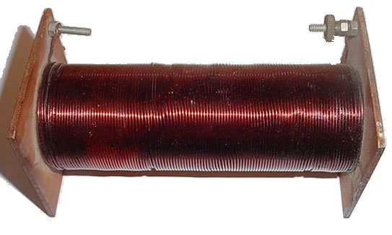
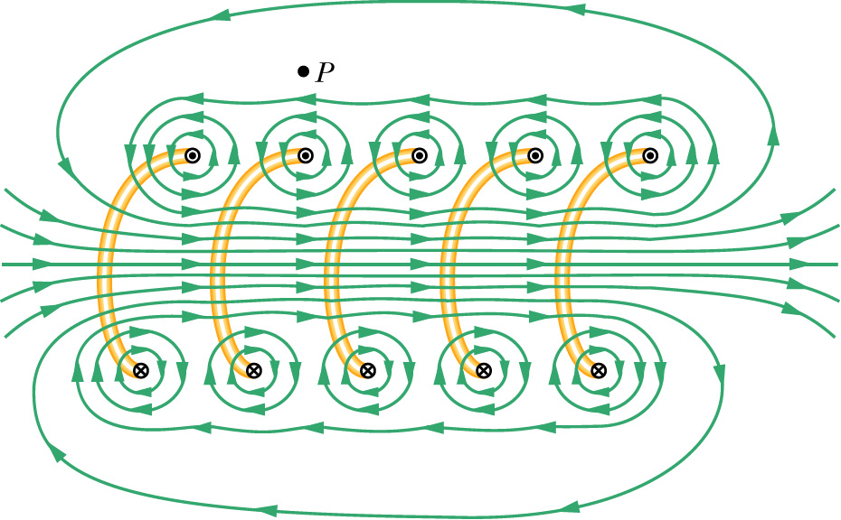
Solenoids
A solenoid, also referred to as a coil, is exactly that. A long wire tightly coiled helically. They are typically characterized by the number of winds per unit length n.
--Solenoids are typically tightly wound, but an spread out version (courtesy of Mr. White) allows us to see their microstructure.
--Between the winds the fields add to zero;
--Outside the winds the field is weak and drops to zero fairly quickly;
--Down the axis, the field is intense;
37.)

Slide 38
Trickery
There is still another right-hand rule that can be used to determine the direction of the magnetic field due to current through a coil. It’s easy (and fun!).
Lay your right-hand on the coil with your fingers pointing in the direction of the current.
The direction your thumb points is the direction of the B-fld down the axis of the coil.
38.)

Slide 39
Other Devices
A little more sophisticated version of a motor required one bit of information that would normally not be covered until next chapter.
It is charge in motion that generates magnetic fields. With current carrying coils, the generated magnetic fields are down the axis and through the face of the coil.
A handy trick to determine the direction of a current carrying wire’s B-fld is to lay your right hand on the coil with your fingers following the direction of current in the coil. The direction in which your extended right-thumb points identifies the direction of the coil’s B-fld.
direction of
B-fld
this end of
coil acts like
a north pole
Note that with the B-fld extending along the axis as it does, the coil’s ends look like north and south poles.
With that, consider the following:
39.)

Slide 40
Electromagnetics
Because a coil sets up a magnetic field down its axis, as shown in the sketch, a tightly wound coil will act like a bar magnet in the sense that it will have one end that acts like a north pole and one end that acts like a south pole.
And because a ferromagnetic material (iron, steel, etc.) has within it magnetic domains that can align themselves to an external magnetic field, it is possible to make a very strong electromagnet by slipping a piece of iron (for instance) down the axis of a coil, then sending a current through the coil. That, in fact, is how electromagnets are made.
piece of iron
40.)

Slide 41

Follow the current from the battery, through the brushes to the coil, then determine the B-fld due to the coil’s current (see below).
Fingers of right hand curl along line of current;
thumb identifies
direction of B-
field (with B-
field lines exiting this end, so it’s a North Pole)
41.)

Slide 42
Notice the attractions between the poles . . . these cause rotation . . .
42.)

Slide 43
More attractions, more rotation . . .
43.)

Slide 44
Brushes not in contact—current in coils about to change direction–momentum carries motion . . .
44.)

Slide 45
Notice the repulsion between the poles . . . still getting rotation . . .
45.)

Slide 46
Back to attraction . . .
This is a DC motor. . .
46.)

Slide 47

What is it?
What you are looking at here is the circuit for an old-fashioned door bell. See if you can follow through to see how the mechanism works (note the direction of the magnetic field in the green horseshoe electromagnet, and the direction of the induced magnetic field in the blue bar opposite the poles of the horseshoe magnetic, when the current flows).
47.)

Slide 48
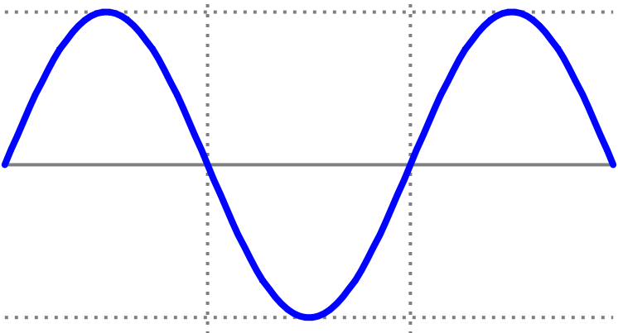
What is it?
This is the design for a loud speaker (actually, the coil and magnet are usually switched in real line). This is how it works:
a.) Let’s assume we want to project a 256 Hz (middle C) sound wave into the room. The signal would look like the sine wave shown below.
S
N
coil
cone (constrained
at the edges)
48.)

Slide 49
b.) During the first half of the cycle, let’s assume the direction of the time-varying current through the coil is directed as shown on the sketch. There are two things to note:
S
N
coil
i.) Being sinusoidal, the current will increase to a maximum, then will drop back down to zero whereupon the direction will change and the current will again increase to a maximum in the opposite direction, then proceed back to zero. This pattern will continue through time.
cone (constrained
at the edges)
49.)

Slide 50
ii.) With the current moving in the direction noted, the direction of the induced magnetic field in the coil (alternate right-hand rule) will leave the side of the coil closest to the permanent magnet a North Pole (see sketch).
c.) The north pole of the permanent magnet will interact with the induced north pole of the current carrying coil, and the net effect will be a repulsion experienced by both the coil AND the cone. As the cone is fixed at it’s outside edge, this will flex the cone outward with the amount of flex being dependent upon the size of the current at the given instant.
cone (flexes out)
S
N
N
coil
cone (constrained
at the edges)
d.) As the cone flexes outward, it will compress air into a high pressure region. That pressure ridge will travel away from the cone at approximately 330 m/s, or the speed of sound in air.
50.)

Slide 51
e.) As the current proceeds down toward zero, the cone will relax, pulling back.
f.) When the current direction changes, the direction of the induced magnetic field in the coil will change and the “pulling back” will proceed through equilibrium and into a flexing inward. The degree of flexing will, again, depend upon how much current to moving through the coil at a given instant.
cone (flexes in)
S
N
S
coil
g.) As the cone flexes inward, it will create a rarified region of air generating a low pressure region. That region will travel away from the cone at approximately 330 m/s, or the speed of sound in air.
cone (constrained
at the edges)
h.) This flexing outward, then inward, then outward will occur at the current frequency, or 256 Hz in our example, and the pressure variations will pass by your ear at a frequency of 256 Hz. That, in turn, will wiggle the little hairs in your ears creating electrical impulses that your brain will interpret as sound. Clever of nature, eh?
51.)

Slide 52
HALL EFFECT
An experiment to prove that negative charges moves through electrical circuits when current flows.
How normal current flows through the plate.
BROAD, THIN, METAL PLATE
52.)

Slide 53
What happens when the plate is permeated by B-fld.
plate permeated by B-fld
53.)

Slide 54
. . . if POSITIVE charge is assumed to flow through circuit?
positive charge flow suggests upper side of plate will be high voltage side
positive charge flow
positive charge flow
54.)

Slide 55
. . . if NEGATIVE charge is assumed to flow through circuit?
negative charge flow suggests upper side of plate will be low voltage side
negative charge flow
negative charge flow
55.)

Slide 56
So back to the positive charge-flow assumption:
_
+
V
If there exists a predominance of positive charge on the upper side of the plate making that side of the plate higher voltage than the bottom side, then placing a voltmeter with its + and – terminals as positioned would produce a meter reading that was sensible (that is, the needle would swing in the appropriate direction).
B
R
V
In fact, if this experiment was done, the needle would swing in the wrong direction. In other words, the the meter is hooked up wrong. What are accumulating on the upper side of the plate are not positive charges, they are NEGATIVE charges.
In short, it is negative charge that flows through circuits.
56.)

